Slide 1
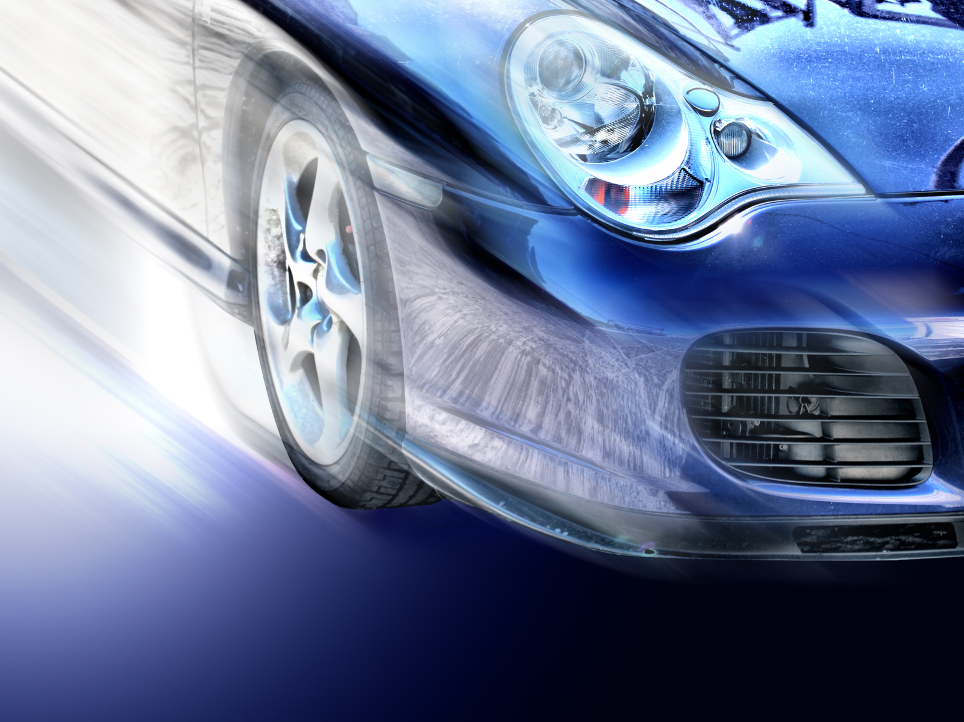
Analyzing the Impact of Car Features on Price and Profitability

Slide 2

The automotive industry has undergone significant changes over the years, with an increasing emphasis on fuel efficiency, environmental responsibility, and technological advancements. As competition in the market intensifies, manufacturers are looking to reshape the consumer market. The goal of this project is to examine the car features that influence manufacturers' pricing decisions. The client, in their role as a Data Analyst, has been tasked with determining how a car manufacturer can optimize pricing and product development strategies to boost profitability while satisfying consumer needs. The dataset includes information on various car models and their features. This dataset is provided by Cooper College in New York City and is available on Kaggle.
PROJECT DESCRIPTION
Total number of observations:- 11,813
File type:- CSV

Slide 3

APPROACH
For analysis I used descriptive statistics, regression analysis, and visualization to visualize the charts and graphs.
The purpose of using descriptive analysis was to determine the average values of the car's feature variables and then represent them through charts and graphs.
Regression analysis revealed how independent variables relate to dependent variables, indicating how specific car features influence the car's price.
When creating the charts, it was challenging to summarize the variable values as sums or averages.

Slide 4
Task 1.A: Create a pivot table that shows the number of car models in each market category and their corresponding popularity scores.
Market Category | Count of Model | Average of Popularity
Crossover | 1110 | 1545.26
Crossover,Diesel | 7 | 873.00
Crossover,Exotic,Luxury,High-Performance | 1 | 238.00
Crossover,Exotic,Luxury,Performance | 1 | 238.00
Crossover,Factory Tuner,Luxury,High-Performance | 26 | 1823.46
Crossover,Factory Tuner,Luxury,Performance | 5 | 2607.40
Crossover,Factory Tuner,Performance | 4 | 210.00
Crossover,Flex Fuel | 64 | 2073.75
Crossover,Flex Fuel,Luxury | 10 | 1173.20
Crossover,Flex Fuel,Luxury,Performance | 6 | 1624.00
Crossover,Flex Fuel,Performance | 6 | 5657.00
Crossover,Hatchback | 72 | 1675.69
Crossover,Hatchback,Factory Tuner,Performance | 6 | 2009.00
Crossover,Hatchback,Luxury | 7 | 204.00
Crossover,Hatchback,Performance | 6 | 2009.00
Crossover,Hybrid | 42 | 2563.38
Crossover,Luxury | 410 | 884.55
Crossover,Luxury,Diesel | 34 | 2149.41
Crossover,Luxury,High-Performance | 9 | 1037.22
Crossover,Luxury,Hybrid | 24 | 630.92
Crossover,Luxury,Performance | 113 | 1344.85
Crossover,Luxury,Performance,Hybrid | 2 | 3916.00
Crossover,Performance | 69 | 2585.96
Market Category | Count of Model | Average of Popularity
Diesel | 84 | 1730.90
Diesel,Luxury | 51 | 2275.00
Exotic,Factory Tuner,High-Performance | 21 | 1046.38
Exotic,Factory Tuner,Luxury,High-Performance | 52 | 517.54
Exotic,Factory Tuner,Luxury,Performance | 3 | 520.00
Exotic,Flex Fuel,Factory Tuner,Luxury,High-Performance | 13 | 520.00
Exotic,Flex Fuel,Luxury,High-Performance | 11 | 520.00
Exotic,High-Performance | 261 | 1271.33
Exotic,Luxury | 12 | 112.67
Exotic,Luxury,High-Performance | 79 | 467.08
Exotic,Luxury,High-Performance,Hybrid | 1 | 204.00
Exotic,Luxury,Performance | 36 | 217.03
Exotic,Performance | 10 | 1391.00
Factory Tuner,High-Performance | 106 | 1941.42
Factory Tuner,Luxury | 2 | 617.00
Factory Tuner,Luxury,High-Performance | 215 | 2133.37
Factory Tuner,Luxury,Performance | 31 | 1413.42
Factory Tuner,Performance | 92 | 1695.70
Flex Fuel | 872 | 2217.30
Flex Fuel,Diesel | 16 | 5657.00
Flex Fuel,Factory Tuner,Luxury,High-Performance | 1 | 258.00
Flex Fuel,Hybrid | 2 | 155.00
Flex Fuel,Luxury | 39 | 746.54
Flex Fuel,Luxury,High-Performance | 33 | 878.91
Flex Fuel,Luxury,Performance | 28 | 1380.07
Flex Fuel,Performance | 87 | 1680.47
Flex Fuel,Performance,Hybrid | 2 | 155.00

Slide 5
Cont…
Market Category | Count of Model | Average of Popularity
Hatchback | 641 | 1318.87
Hatchback,Diesel | 14 | 873.00
Hatchback,Factory Tuner,High-Performance | 13 | 1205.15
Hatchback,Factory Tuner,Luxury,Performance | 9 | 886.89
Hatchback,Factory Tuner,Performance | 22 | 2159.05
Hatchback,Flex Fuel | 7 | 5657.00
Hatchback,Hybrid | 72 | 2121.25
Hatchback,Luxury | 46 | 1379.50
Hatchback,Luxury,Hybrid | 3 | 454.00
Hatchback,Luxury,Performance | 38 | 1566.13
Hatchback,Performance | 252 | 1039.65
High-Performance | 199 | 1821.45
Hybrid | 123 | 2105.57
Luxury | 855 | 1102.66
Luxury,High-Performance | 334 | 1668.02
Luxury,High-Performance,Hybrid | 12 | 568.83
Luxury,Hybrid | 52 | 673.63
Luxury,Performance | 673 | 1292.62
Luxury,Performance,Hybrid | 11 | 2333.18
N/A | 3742 | 1676.89
Performance | 601 | 1348.87
Performance,Hybrid | 1 | 155.00
Grand Total | 11914 | 1554.91
The crossover market category has the most car models, with an average popularity of 1554.91. However, the market category with the highest popularity has a very low count, which has been highlighted in the table.

Slide 6
Task 1.B: Create a combo chart that visualizes the relationship between market category and popularity.
Combo Chart:

Slide 7
Task-2: Create a scatter chart that plots engine power on the x-axis and price on the y-axis. Add a trendline to the chart to visualize the relationship between these variables.
As observed from the increasing costs linked to higher engine power, there seems to be a positive correlation between a car's price and its engine power (HP). For instance, a 1001 HP car is priced at $2,065,902, $1,705,769, and $1,500,000, showing that in these cases, engine power is associated with higher prices.

Slide 8
Task 3: Use regression analysis to identify the variables that have the strongest relationship with a car's price. Then create a bar chart that shows the coefficient values for each variable to visualize their relative importance.
SUMMARY OUTPUT
Regression Statistics
Multiple R | 0.809072367
R Square | 0.654598095
Adjusted R Square | 0.654442425
Standard Error | 39705.10534
Observations | 11099
ANOVA
 | Df | SS | MS | F | Significance F
Regression | 5 | 3.3146E+13 | 6.6292E+12 | 4205.020973 | 0
Residual | 11094 | 1.74896E+13 | 1576495390
Total | 11099 | 5.06356E+13
 | Coefficients | Standard Error | t Stat | P-value | Lower 95% | Upper 95% | Lower 95% | Upper 95%
Intercept | 0 | #N/A | #N/A | #N/A | #N/A | #N/A | #N/A | #N/A
Engine HP | 334.3405457 | 5.538655666 | 60.36492713 | 0 | 323.4837959 | 345.1972955 | 323.4837959 | 345.1972955
Engine Cylinders | -1498.026631 | 300.4372676 | -4.986154489 | 6.25244E-07 | -2086.937089 | -909.1161727 | -2086.937089 | -909.1161727
Number of Doors | -8837.00343 | 386.8729016 | -22.84213599 | 6.863E-113 | -9595.343097 | -8078.663762 | -9595.343097 | -8078.663762
Highway MPG | -471.3675619 | 88.39932138 | -5.332253173 | 9.89066E-08 | -644.645948 | -298.0891759 | -644.645948 | -298.0891759
City MPG | 461.554847 | 108.4742457 | 4.254971712 | 2.10792E-05 | 248.9260402 | 674.1836538 | 248.9260402 | 674.1836538

Slide 9
Task 3: A bar chart that shows the coefficient values for each variable to visualize their relative importance.
By performing regression analysis, it can be understood that the engine cylinders has the strongest relationship with the car’s price. Hence it can be said that as per the analysis the engine cylinders is the most important car feature in determining the car’s price.

Slide 10
Task 4.A: A pivot table that shows the average price of cars for each manufacturer.
Manufacturer | Average of Price
Hyundai | 24597.0363
Infiniti | 42394.21212
Kia | 25310.17316
Lamborghini | 331567.3077
Land Rover | 67823.21678
Lexus | 47549.06931
Lincoln | 42839.82927
Lotus | 69188.27586
Maserati | 114207.7069
Maybach | 546221.875
Mazda | 20039.38298
McLaren | 239805
Mercedes-Benz | 71476.22946
Mitsubishi | 21240.53521
Nissan | 28583.4319
Oldsmobile | 11542.54
Plymouth | 3122.902439
Pontiac | 19321.54839
Porsche | 101622.3971
Rolls-Royce | 351130.6452
Saab | 27413.5045
Scion | 19932.5
Spyker | 213323.3333
Subaru | 24827.50391
Suzuki | 17907.20798
Tesla | 85255.55556
Toyota | 29030.01609
Volkswagen | 28102.38072
Volvo | 28541.16014
Grand Total | 40594.73703
Manufacturer | Average of Price
Acura | 34887.5873
Alfa Romeo | 61600
Aston Martin | 197910.3763
Audi | 53452.1128
Bentley | 247169.3243
BMW | 61546.76347
Bugatti | 1757223.667
Buick | 28206.61224
Cadillac | 56231.31738
Chevrolet | 28350.38557
Chrysler | 26722.96257
Dodge | 22390.05911
Ferrari | 238218.8406
FIAT | 22670.24194
Ford | 27399.26674
Genesis | 46616.66667
GMC | 30493.29903
Honda | 26674.34076
HUMMER | 36464.41176

Slide 11
Task 4.B: A bar chart or a horizontal stacked bar chart that visualizes the relationship between manufacturer and average price
From the data, we can see that Bugatti has the highest average price among all brands, with an average of $1,757,224. Maybach follows, with an average price of $546,222. This information can be valuable for car manufacturers when it comes to pricing strategies and market positioning.

Slide 12
Task 5.A: A scatter plot with the number of cylinders on the x-axis and highway MPG on the y-axis. Then create a trendline on the scatter plot to visually estimate the slope of the relationship and assess its significance.

Slide 13
Task 5.A: Correlation coefficient between the number of cylinders and highway MPG to quantify the strength and direction of the relationship.
Correlation Coefficient
-0.620312551
The investigation shows that highway MPG generally decreases as the number of engine cylinders increases, indicating a negative relationship between the two variables. For example, a car with 16 cylinders has the lowest highway MPG at 14, illustrating how larger engines impact fuel efficiency.
Moreover, the correlation coefficient of -0.620312551 highlights a strong negative relationship between the number of cylinders and highway MPG. This statistic confirms that as the cylinder count goes up, highway MPG typically goes down.

Slide 14
Building the Dashboard

Slide 15
Task 1: How does the distribution of car prices vary by brand and body style?
Row Labels | 2dr Hatchback | 2dr SUV | 4dr Hatchback | 4dr SUV | Cargo Minivan | Cargo Van | Convertible | Convertible SUV | Coupe | Crew Cab Pickup | Extended Cab Pickup | Passenger Minivan | Passenger Van | Regular Cab Pickup | Sedan | Wagon | Grand Total
Acura | 480917 |  | 357440 | 2663505 |  |  |  |  | 793748 |  |  |  |  |  | 4294702 | 201360 | 8791672
Alfa Romeo |  |  |  |  |  |  | 129800 |  | 178200 |  |  |  |  |  |  |  | 308000
Aston Martin |  |  |  |  |  |  | 7321655 |  | 9635275 |  |  |  |  |  | 1448735 |  | 18405665
Audi | 4000 |  |  | 2674900 |  |  | 3291405 |  | 3556290 |  |  |  |  |  | 7158348 | 847350 | 17532293
Bentley |  |  |  |  |  |  | 6012870 |  | 6356760 |  |  |  |  |  | 5920900 |  | 18290530
BMW | 80097 |  | 1144950 | 3160950 |  |  | 4502671 |  | 3419051 |  |  |  |  |  | 7989300 | 259600 | 20556619
Bugatti |  |  |  |  |  |  |  |  | 5271671 |  |  |  |  |  |  |  | 5271671
Buick |  |  |  | 2141770 |  |  | 179325 |  | 18534 |  |  | 330065 |  |  | 2850590 | 8212 | 5528496
Cadillac |  |  |  | 7182555 |  |  | 985607 |  | 2953574 | 599150 |  |  |  |  | 9418847 | 1184100 | 22323833
Chevrolet | 8000 | 213310 | 1209735 | 6569568 | 420150 | 78688 | 2953245 | 106300 | 3504525 | 5927617 | 3117951 | 1178515 | 607670 | 2260032 | 3068812 | 300675 | 31524793
Chrysler | 98805 |  |  | 250545 |  |  | 630105 |  | 114510 |  |  | 922295 |  |  | 2479859 | 501075 | 4997194
Dodge | 48000 | 44000 | 18000 | 2572405 | 60520 | 338497 | 12000 |  | 3264627 | 2235775 | 864172 | 557425 | 70708 | 719408 | 2417585 | 793055 | 14016177
Ferrari |  |  |  |  |  |  | 4723811 |  | 11418289 |  |  |  |  |  |  |  | 16142100
FIAT | 325315 |  |  | 369305 |  |  | 327965 |  |  |  |  |  |  |  |  | 287570 | 1310155
Ford | 36000 | 479873 | 480155 | 4370871 | 680770 | 566351 | 730007 |  | 1398144 | 3812353 | 2285584 | 1271330 | 2431898 | 1299240 | 2299348 | 1635565 | 23777489
Genesis |  |  |  |  |  |  |  |  |  |  |  |  |  |  | 139850 |  | 139850
GMC |  | 144319 |  | 6641919 | 142750 | 468085 |  |  |  | 4062482 | 2183866 | 150630 | 603670 | 1306328 |  |  | 15704049
Honda | 413200 |  | 2015270 | 3953209 |  |  | 252135 |  | 1588705 | 787720 |  | 553185 |  |  | 2340105 |  | 11903529
HUMMER |  |  |  | 377490 |  |  |  |  |  | 242405 |  |  |  |  |  |  | 619895
Hyundai | 1038050 |  | 528880 | 2128890 |  |  |  |  | 724070 |  |  | 133075 |  |  | 2899937 |  | 7452902
Infiniti |  |  |  | 4340200 |  |  | 980050 |  | 2175750 |  |  |  |  |  | 6494090 |  | 13990090
Kia |  |  | 406960 | 2049645 |  |  |  |  | 142630 |  |  | 494650 |  |  | 1980360 | 601155 | 5675400
Lamborghini |  |  |  |  |  |  | 7064450 |  | 10177050 |  |  |  |  |  |  |  | 17241500
Land Rover |  | 476394 |  | 9076595 |  |  |  | 145731 |  |  |  |  |  |  |  |  | 9698720
Lexus |  |  | 94700 | 3152974 |  |  | 472065 |  | 1016472 |  |  |  |  |  | 4837596 | 31105 | 9604912
Lincoln |  |  |  | 3422570 |  |  |  |  | 25342 | 453260 |  |  |  |  | 2458245 | 269705 | 6629122
Lotus |  |  |  |  |  |  | 413260 |  | 1593200 |  |  |  |  |  |  |  | 2006460
Maserati |  |  |  | 155000 |  |  | 2342963 |  | 1972284 |  |  |  |  |  | 2153800 |  | 6624047
Maybach |  |  |  |  |  |  | 2762750 |  |  |  |  |  |  |  | 5976800 |  | 8739550
Mazda | 22000 | 24000 | 853180 | 3222525 |  |  | 870505 |  | 14000 |  | 580033 | 443130 |  | 265486 | 1618571 | 33350 | 7946780
McLaren |  |  |  |  |  |  | 280225 |  | 918800 |  |  |  |  |  |  |  | 1199025
Mercedes-Benz |  |  | 122800 | 4924810 | 28950 |  | 5753964 |  | 6473107 |  |  | 32500 |  |  | 7080243 | 764935 | 25181309
Mitsubishi | 394868 |  | 338850 | 2066505 | 2000 |  | 209893 |  |  | 240210 | 134360 | 2000 |  | 8000 | 1058563 |  | 4455249
Nissan | 14683 |  | 1023090 | 4149630 | 128620 |  | 1406552 | 131075 | 2943632 | 2422300 | 1026379 | 413320 |  | 21914 | 1769130 | 175000 | 15625325
Oldsmobile |  |  |  | 238150 |  |  | 2000 |  | 286015 |  |  | 492055 |  |  | 691161 | 22000 | 1731381
Plymouth | 42000 |  | 16000 |  |  |  | 85631 |  | 14000 |  |  | 33688 |  |  | 46759 | 18000 | 256078
Pontiac | 163505 |  | 162975 | 401550 |  |  | 473481 |  | 667715 |  |  | 541192 |  |  | 1160535 | 22855 | 3593808
Porsche | 28827 |  |  | 1815200 |  |  | 4504586 |  | 4758533 |  |  |  |  |  | 2713500 |  | 13820646
Rolls-Royce |  |  |  |  |  |  | 2141365 |  | 2204675 |  |  |  |  |  | 6539010 |  | 10885050
Saab | 14000 |  | 36586 | 541905 |  |  | 632628 |  |  |  |  |  |  |  | 1066500 | 751280 | 3042899
Scion | 366325 |  | 282470 |  |  |  |  |  | 330210 |  |  |  |  |  | 32500 | 184445 | 1195950
Spyker |  |  |  |  |  |  | 219990 |  | 419980 |  |  |  |  |  |  |  | 639970
Subaru | 12000 |  | 678060 | 3020230 |  |  |  |  | 356476 | 365975 |  |  |  |  | 1913100 | 10000 | 6355841
Suzuki | 46496 | 14000 | 584387 | 2362141 |  |  |  | 122194 |  | 304131 | 259659 |  |  |  | 1850818 | 685707 | 6229533
Toyota | 473750 |  | 1397750 | 4957050 |  |  | 386668 |  | 811995 | 3893760 | 3558504 | 1956518 |  | 373446 | 2459596 | 1237955 | 21506992
Volkswagen | 4171275 |  | 3222275 | 2084955 |  |  | 3612631 |  | 8000 |  |  | 1038130 |  |  | 6760050 | 1704025 | 22601341
Volvo | 157550 |  |  | 3219000 |  |  | 121600 |  | 6000 |  |  |  |  |  | 2086945 | 2428971 | 8020066
Grand Total | 8439663 | 1395896 | 14974513 | 100258517 | 1463760 | 1451621 | 66789858 | 505300 | 91511839 | 25347138 | 14010508 | 10543703 | 3713946 | 6253854 | 117474790 | 14959050 | 479093956

Slide 16
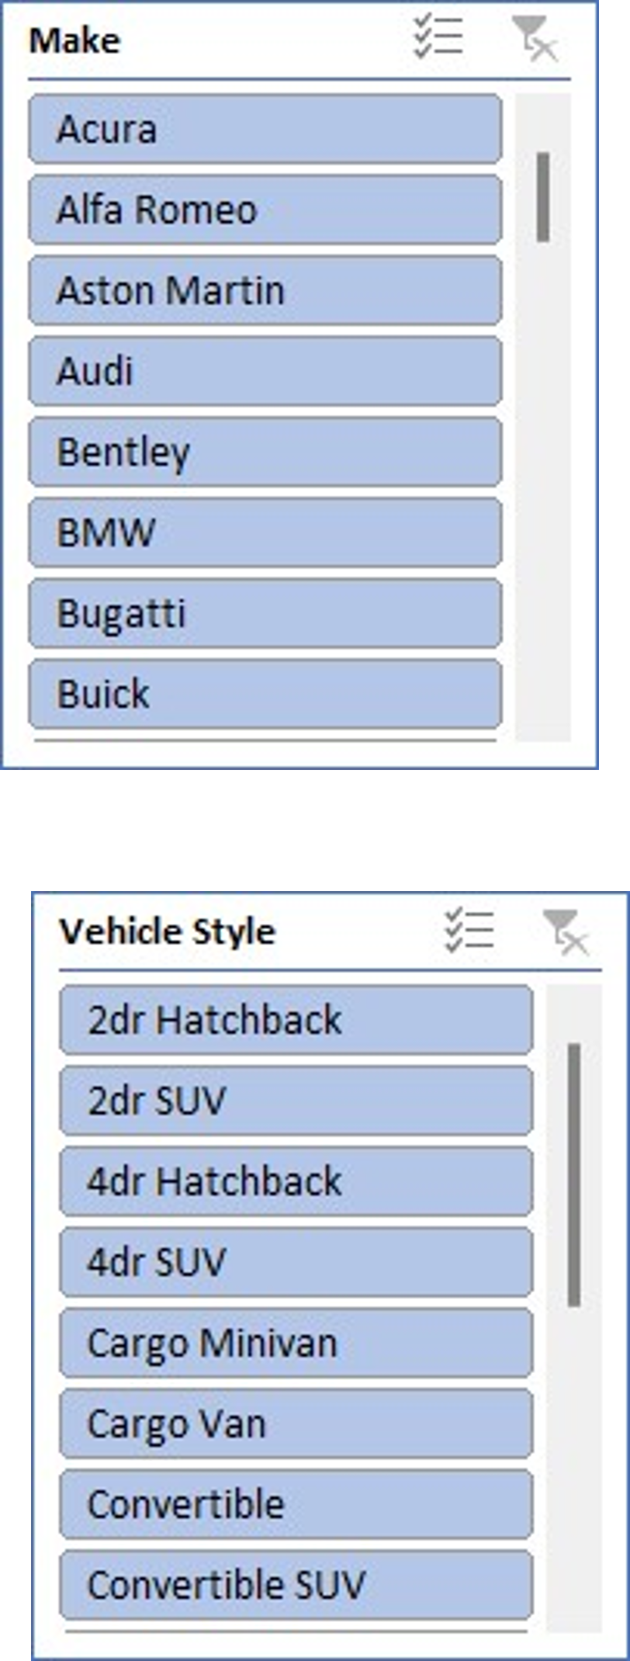
Task 1: Stacked column chart to show the distribution of car prices by brand and body style
Pivot table is utilized to create stacked column chart. It can be observed that Cadillac has the highest sum of MSRP indicating highest sales in all vehicle styles.

Slide 17
Task 2: Which car brands have the highest and lowest average MSRPs, and how does this vary by body style?
Make | Average of MSRP
Acura | 34887.59
Alfa Romeo | 61600.00
Aston Martin | 197910.38
Audi | 53452.11
Bentley | 247169.32
BMW | 61546.76
Bugatti | 1757223.67
Buick | 28206.61
Cadillac | 56231.32
Chevrolet | 28273.36
Chrysler | 26722.96
Dodge | 22390.06
Ferrari | 237383.82
FIAT | 22206.02
Ford | 27393.42
Genesis | 46616.67
GMC | 30493.30
Honda | 26629.82
HUMMER | 36464.41
Hyundai | 24597.04
Infiniti | 42394.21
Kia | 25112.39
Lamborghini | 331567.31
Land Rover | 67823.22
Make | Average of MSRP
Lexus | 47549.07
Lincoln | 42494.37
Lotus | 69188.28
Maserati | 114207.71
Maybach | 546221.88
Mazda | 19719.06
McLaren | 239805.00
Mercedes-Benz | 71537.81
Mitsubishi | 21215.47
Nissan | 28513.37
Oldsmobile | 11542.54
Plymouth | 3122.90
Pontiac | 19321.55
Porsche | 101622.40
Rolls-Royce | 351130.65
Saab | 27413.50
Scion | 19932.50
Spyker | 213323.33
Subaru | 24827.50
Suzuki | 17900.96
Toyota | 28946.15
Volkswagen | 28076.20
Volvo | 28541.16

Slide 18
Task 2: how does this vary by body style?
Average of MSRP | Column Labels
Row Labels | 2dr Hatchback | 2dr SUV | 4dr Hatchback | 4dr SUV | Cargo Minivan | Cargo Van | Convertible | Convertible SUV | Coupe | Crew Cab Pickup | Extended Cab Pickup | Passenger Minivan | Passenger Van | Regular Cab Pickup | Sedan | Wagon | Grand Total
Acura | 17175.60714 |  | 51062.85714 | 42959.75806 |  |  |  |  | 39687.4 |  |  |  |  |  | 33292.26357 | 33560 | 34887.5873
Alfa Romeo |  |  |  |  |  |  | 64900 |  | 59400 |  |  |  |  |  |  |  | 61600
Aston Martin |  |  |  |  |  |  | 203379.3056 |  | 192705.5 |  |  |  |  |  | 206962.1429 |  | 197910.3763
Audi | 2000 |  |  | 48634.54545 |  |  | 70029.89362 |  | 93586.57895 |  |  |  |  |  | 44461.78882 | 33894 | 53452.1128
Bentley |  |  |  |  |  |  | 250536.25 |  | 254270.4 |  |  |  |  |  | 236836 |  | 247169.3243
BMW | 26699 |  | 54521.42857 | 58536.11111 |  |  | 63417.90141 |  | 51803.80303 |  |  |  |  |  | 70701.76991 | 43266.66667 | 61546.76347
Bugatti |  |  |  |  |  |  |  |  | 1757223.667 |  |  |  |  |  |  |  | 1757223.667
Buick |  |  |  | 33996.34921 |  |  | 25617.85714 |  | 2059.333333 |  |  | 30005.90909 |  |  | 27946.96078 | 2053 | 28206.61224
Cadillac |  |  |  | 72551.06061 |  |  | 70400.5 |  | 45439.6 | 66572.22222 |  |  |  |  | 50912.68649 | 47364 | 56231.31738
Chevrolet | 2000 | 8887.916667 | 18329.31818 | 32046.67317 | 20007.14286 | 7153.454545 | 62835 | 17716.66667 | 38939.16667 | 39255.74172 | 24170.16279 | 24552.39583 | 24306.8 | 19824.84211 | 19798.7871 | 15825 | 28273.35695
Chrysler | 32935 |  |  | 35792.14286 |  |  | 24234.80769 |  | 19085 |  |  | 29751.45161 |  |  | 26103.77895 | 26372.36842 | 26722.96257
Dodge | 2000 | 2000 | 2000 | 30992.83133 | 20173.33333 | 12536.92593 | 2000 |  | 45980.66197 | 31052.43056 | 13938.25806 | 25337.5 | 14141.6 | 9342.961039 | 21780.04505 | 24782.96875 | 22390.05911
Ferrari |  |  |  |  |  |  | 214718.6818 |  | 248223.6739 |  |  |  |  |  |  |  | 237383.8235
FIAT | 19136.17647 |  |  | 24620.33333 |  |  | 23426.07143 |  |  |  |  |  |  |  |  | 22120.76923 | 22206.01695
Ford | 2000 | 13710.65714 | 18467.5 | 42027.60577 | 21274.0625 | 17698.46875 | 34762.2381 |  | 34101.07317 | 41438.61957 | 23808.16667 | 23115.09091 | 32425.30667 | 17797.80822 | 21290.25926 | 27259.41667 | 27393.42051
Genesis |  |  |  |  |  |  |  |  |  |  |  |  |  |  | 46616.66667 |  | 46616.66667
GMC |  | 5550.730769 |  | 36695.68508 | 23791.66667 | 18723.4 |  |  |  | 39062.32692 | 26632.5122 | 25105 | 26246.52174 | 21069.80645 |  |  | 30493.29903
Honda | 17216.66667 |  | 25836.79487 | 28855.54015 |  |  | 36019.28571 |  | 21763.08219 | 34248.69565 |  | 36879 |  |  | 26001.16667 |  | 26629.81879
HUMMER |  |  |  | 37749 |  |  |  |  |  | 34629.28571 |  |  |  |  |  |  | 36464.41176
Hyundai | 18536.60714 |  | 17629.33333 | 30412.71429 |  |  |  |  | 20687.71429 |  |  | 26615 |  |  | 27102.21495 |  | 24597.0363
Infiniti |  |  |  | 45686.31579 |  |  | 46669.04762 |  | 40291.66667 |  |  |  |  |  | 40588.0625 |  | 42394.21212
Kia |  |  | 19379.04762 | 31533 |  |  |  |  | 20375.71429 |  |  | 32976.66667 |  |  | 23298.35294 | 18216.81818 | 25112.38938
Lamborghini |  |  |  |  |  |  | 336402.381 |  | 328291.9355 |  |  |  |  |  |  |  | 331567.3077
Land Rover |  | 39699.5 |  | 70910.89844 |  |  |  | 48577 |  |  |  |  |  |  |  |  | 67823.21678
Lexus |  |  | 31566.66667 | 45042.48571 |  |  | 52451.66667 |  | 50823.6 |  |  |  |  |  | 48864.60606 | 31105 | 47549.06931
Lincoln |  |  |  | 50331.91176 |  |  |  |  | 2111.833333 | 41205.45455 |  |  |  |  | 41665.16949 | 44950.83333 | 42494.37179
Lotus |  |  |  |  |  |  | 51657.5 |  | 75866.66667 |  |  |  |  |  |  |  | 69188.27586
Maserati |  |  |  | 77500 |  |  | 130164.6111 |  | 116016.7059 |  |  |  |  |  | 102561.9048 |  | 114207.7069
Maybach |  |  |  |  |  |  | 1381375 |  |  |  |  |  |  |  | 426914.2857 |  | 546221.875
Mazda | 2000 | 2000 | 20809.26829 | 27080.04202 |  |  | 28080.80645 |  | 2000 |  | 11600.66 | 23322.63158 |  | 9154.689655 | 19738.67073 | 16675 | 19719.05707
McLaren |  |  |  |  |  |  | 280225 |  | 229700 |  |  |  |  |  |  |  | 239805
Mercedes-Benz |  |  | 40933.33333 | 68400.13889 | 28950 |  | 104617.5273 |  | 109713.678 |  |  | 32500 |  |  | 49168.35417 | 44996.17647 | 71537.80966
Mitsubishi | 13162.26667 |  | 12101.78571 | 26158.29114 | 2000 |  | 29984.71429 |  |  | 26690 | 19194.28571 | 2000 |  | 2000 | 24058.25 |  | 21215.47143
Nissan | 2097.571429 |  | 22241.08696 | 34294.46281 | 21436.66667 |  | 39070.88889 | 43691.66667 | 34228.27907 | 32733.78378 | 20527.58 | 22962.22222 |  | 2191.4 | 21841.11111 | 17500 | 28513.36679
Oldsmobile |  |  |  | 34021.42857 |  |  | 2000 |  | 9226.290323 |  |  | 32803.66667 |  |  | 8131.305882 | 2000 | 11542.54
Plymouth | 2000 |  | 2000 |  |  |  | 28543.66667 |  | 2000 |  |  | 2105.5 |  |  | 2597.722222 | 2000 | 3122.902439
Pontiac | 18167.22222 |  | 18108.33333 | 25096.875 |  |  | 22546.71429 |  | 15528.25581 |  |  | 20815.07692 |  |  | 20009.22414 | 5713.75 | 19321.54839
Porsche | 5765.4 |  |  | 82509.09091 |  |  | 115502.2051 |  | 99136.10417 |  |  |  |  |  | 123340.9091 |  | 101622.3971
Rolls-Royce |  |  |  |  |  |  | 428273 |  | 367445.8333 |  |  |  |  |  | 326950.5 |  | 351130.6452
Saab | 2000 |  | 2032.555556 | 41685 |  |  | 28755.81818 |  |  |  |  |  |  |  | 36775.86207 | 34149.09091 | 27413.5045
Scion | 20351.38889 |  | 15692.77778 |  |  |  |  |  | 27517.5 |  |  |  |  |  | 16250 | 18444.5 | 19932.5
Spyker |  |  |  |  |  |  | 219990 |  | 209990 |  |  |  |  |  |  |  | 213323.3333
Subaru | 2000 |  | 21189.375 | 29322.62136 |  |  |  |  | 15498.95652 | 24398.33333 |  |  |  |  | 26570.83333 | 2000 | 24827.50391
Suzuki | 6642.285714 | 2000 | 16696.77143 | 21090.54464 |  |  |  | 7187.882353 |  | 27648.27273 | 21638.25 |  |  |  | 18145.27451 | 15237.93333 | 17900.9569
Toyota | 18950 |  | 22186.50794 | 40631.55738 |  |  | 25777.86667 |  | 15615.28846 | 37803.49515 | 26359.28889 | 29201.76119 |  | 16236.78261 | 24844.40404 | 31742.4359 | 28946.15343
Volkswagen | 24251.59884 |  | 27778.23276 | 41699.1 |  |  | 27789.46923 |  | 2000 |  |  | 25320.2439 |  |  | 29911.72566 | 25818.56061 | 28076.2
Volvo | 26258.33333 |  |  | 45338.02817 |  |  | 40533.33333 |  | 2000 |  |  |  |  |  | 20869.45 | 24785.41837 | 28541.16014
Grand Total | 16778.65408 | 10115.18841 | 22086.30236 | 40426.82137 | 20910.85714 | 15280.22105 | 84224.28499 | 17424.13793 | 76900.70504 | 37220.46696 | 22488.77689 | 25591.51214 | 29015.20313 | 15953.70918 | 38989.30966 | 25483.90119 | 40559.93532

Slide 19
Task 2: Clustered column chart to compare the average MSRPs across different car brands and body styles
Playmouth has lowest average MSRP of 3122.90 while Bugatti has highest average MSRP of 1757223.67

Slide 20
Task 3: How do the different feature such as transmission type affect the MSRP, and how does this vary by body style?
Sum of MSRP | Column Labels
Row Labels | AUTOMATED_MANUAL | AUTOMATIC | DIRECT_DRIVE | MANUAL | UNKNOWN | Grand Total
2dr Hatchback | 1549315 | 2615808 |  | 4259817 | 14723 | 8439663
2dr SUV |  | 819069 |  | 567343 | 9484 | 1395896
4dr Hatchback | 1579450 | 8389455 | 448655 | 4556953 |  | 14974513
4dr SUV | 1051730 | 97571582 |  | 1635205 |  | 100258517
Cargo Minivan |  | 1463760 |  |  |  | 1463760
Cargo Van |  | 1451621 |  |  |  | 1451621
Convertible | 16369647 | 30454162 |  | 19954482 | 11567 | 66789858
Convertible SUV |  | 311404 |  | 193896 |  | 505300
Coupe | 30944133 | 31606744 |  | 28956962 | 4000 | 91511839
Crew Cab Pickup |  | 24269438 |  | 1077700 |  | 25347138
Extended Cab Pickup |  | 11213270 |  | 2797238 |  | 14010508
Passenger Minivan |  | 10477623 |  | 66080 |  | 10543703
Passenger Van |  | 3713946 |  |  |  | 3713946
Regular Cab Pickup |  | 4537355 |  | 1700499 | 16000 | 6253854
Sedan | 9927230 | 97749071 | 55645 | 9740844 | 2000 | 117474790
Wagon | 575735 | 11956512 |  | 2426803 |  | 14959050
Grand Total | 61997240 | 338600820 | 504300 | 77933822 | 57774 | 479093956

Slide 21
Task 3: Scatter plot chart to visualize the relationship between MSRP and transmission type

Slide 22
Task 4: How does the fuel efficiency of cars vary across different body styles and model years?
Year | Average of highway MPG
1990 | 23.07
1991 | 22.15
1992 | 24.05
1993 | 24.22
1994 | 23.87
1995 | 23.23
1996 | 23.73
1997 | 22.31
1998 | 21.85
1999 | 22.98
2000 | 24.04
2001 | 23.71
2002 | 22.77
2003 | 22.74
Year | Average of highway MPG
2004 | 23.13
2005 | 23.64
2006 | 23.42
2007 | 21.94
2008 | 22.99
2009 | 23.89
2010 | 24.17
2011 | 25.23
2012 | 26.35
2013 | 27.45
2014 | 26.89
2015 | 28.51
2016 | 28.54
2017 | 28.33
Grand Total | 26.32

Slide 23
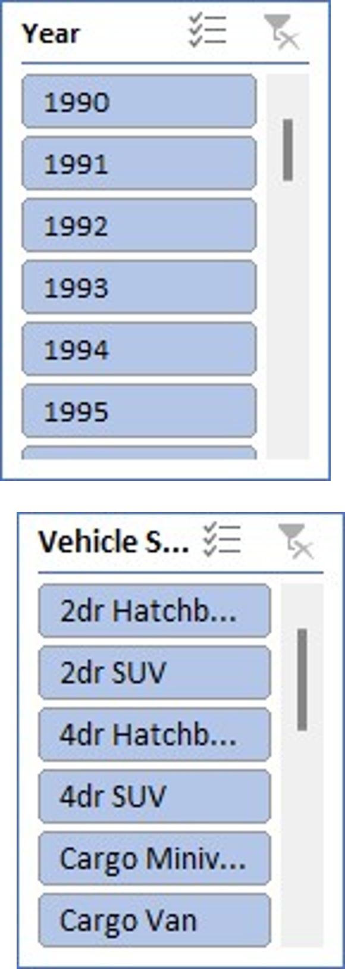
Task 4: How does the fuel efficiency of cars vary across different body styles and model years?
According to the data, there appears to be a tendency towards increased fuel efficiency as car model years advance, which may be attributed to developments in automotive technology and legislation aimed at reducing emissions and improving fuel economy.

Slide 24
Task 5: How does the car's horsepower, MPG, and price vary across different Brands?
Make | Average of Engine HP | Average of Highway MPG | Average of MSRP
Acura | 244.797619 | 28.11111111 | 34887.5873
Alfa Romeo | 237 | 34 | 61600
Aston Martin | 484.3225806 | 18.89247312 | 197910.3763
Audi | 277.695122 | 28.82317073 | 53452.1128
Bentley | 533.8513514 | 18.90540541 | 247169.3243
BMW | 326.9071856 | 29.24550898 | 61546.76347
Bugatti | 1001 | 14 | 1757223.667
Buick | 219.244898 | 26.94897959 | 28206.61224
Cadillac | 332.3098237 | 25.23677582 | 56231.31738
Chevrolet | 247.0565022 | 25.6690583 | 28273.35695
Chrysler | 229.1390374 | 26.36898396 | 26722.96257
Dodge | 244.4153355 | 22.34504792 | 22390.05911
Ferrari | 509.9117647 | 15.72058824 | 237383.8235
FIAT | 143.559322 | 33.91525424 | 22206.01695
Ford | 243.0979263 | 23.74078341 | 27393.42051
Genesis | 347.3333333 | 25.33333333 | 46616.66667
GMC | 259.8446602 | 21.4038835 | 30493.29903
Honda | 195.7494407 | 32.25055928 | 26629.81879
HUMMER | 261.2352941 | 17.29411765 | 36464.41176
Hyundai | 201.9174917 | 30.39273927 | 24597.0363
Infiniti | 310.0666667 | 24.77878788 | 42394.21212
Kia | 206.8274336 | 29.29646018 | 25112.38938
Lamborghini | 614.0769231 | 18.01923077 | 331567.3077
Land Rover | 322.0979021 | 22.12587413 | 67823.21678
Make | Average of Engine HP | Average of Highway MPG | Average of MSRP
Lexus | 277.4158416 | 25.87623762 | 47549.06931
Lincoln | 284.9102564 | 24.1025641 | 42494.37179
Lotus | 275.9655172 | 26.55172414 | 69188.27586
Maserati | 420.7931034 | 20.29310345 | 114207.7069
Maybach | 590.5 | 16 | 546221.875
Mazda | 169.191067 | 28.11662531 | 19719.05707
McLaren | 610.4 | 22.2 | 239805
Mercedes-Benz | 350.1818182 | 24.81818182 | 71537.80966
Mitsubishi | 174.452381 | 26.50952381 | 21215.47143
Nissan | 239.9215328 | 26.46350365 | 28513.36679
Oldsmobile | 177.4666667 | 26.23333333 | 11542.54
Plymouth | 131.5609756 | 27.96341463 | 3122.902439
Pontiac | 190.2956989 | 27.06989247 | 19321.54839
Porsche | 392.7941176 | 25.36764706 | 101622.3971
Rolls-Royce | 487.5483871 | 19.12903226 | 351130.6452
Saab | 220.5225225 | 26.35135135 | 27413.5045
Scion | 154.4333333 | 32.3 | 19932.5
Spyker | 400 | 18 | 213323.3333
Subaru | 197.3085938 | 28.68359375 | 24827.50391
Suzuki | 160.3333333 | 26.04310345 | 17900.9569
Toyota | 236.2584118 | 26.26110363 | 28946.15343
Volkswagen | 190.1291925 | 31.76645963 | 28076.2
Volvo | 230.9715302 | 27.20284698 | 28541.16014
Grand Total | 249.504487 | 26.3209448 | 40559.93532

Slide 25
Task 5: Bubble chart to visualize the relationship between horsepower, MPG, and price across different car brands.

Slide 26
Conclusion
Integration of Conservation and Cultural Preservation: Seacology's strategy effectively combines environmental conservation with the protection of indigenous cultures, recognizing the interdependence of cultural diversity and biodiversity.
Empowerment of Local Communities: By developing culturally sensitive programs, Seacology empowers local communities to protect both their natural environments and cultural heritage.
Support for Sustainable Economic Development: The focus on sustainable, eco-friendly income-generating activities helps preserve cultural traditions while promoting economic stability.
Effective Monitoring and Evaluation: Seacology’s M&E framework ensures project success and sustainability through regular field visits, community feedback, and adaptive management.
Long-term Impact and Cultural Resilience: Seacology's dual focus on conservation and cultural preservation fosters long-term environmental and cultural resilience, serving as a model for future conservation efforts.

Slide 27
Thank You…!

